Slide 1
Chapter 7: Structural and Behavioral
Design Patterns
Session II: Behavioral Design Patterns,
Iterator, Observer

Slide 2
Session’s Agenda
Behavioral Patterns in Detailed Design
Iterator
  Example…
Observer…
  Example…
What’s next…

Slide 3

Behavioral Design Patterns
Behavioral design patterns are patterns that deal with encapsulating behavior with objects, assigning responsibility, and managing object cooperation when achieving common tasks [1].
  They include many of the mainstream design patterns used in modern object-oriented frameworks and play a key role in the design of systems by making them independent of specific behavior, which is made replaceable with objects throughout these design patterns.
Popular behavioral design patterns include:
  Iterator
  Observer
  Others not covered:
    Command
    Chain of responsibility
    Interpreter
    Mediator
    Memento
    State
    Strategy
    Template Method
    Visitor

Slide 4
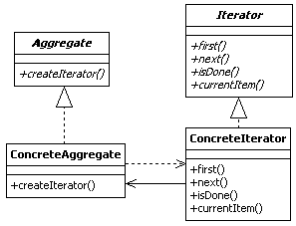
Iterator Design Pattern
The Iterator design pattern is an object behavioral pattern that provides a standardized way for accessing and traversing objects in a collection data structure.
According to the GoF, the intent of the Iterators to [1],
  Provide a way to access the elements of an aggregate object sequentially without exposing its underlying representation.
Iterator interface specifies a uniform way for traversing a collection data structure
Concrete Iterators must obey the Iterator interface!

Slide 5
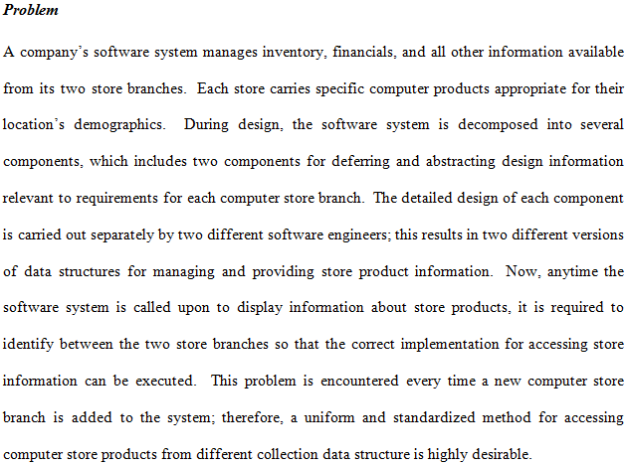
Iterator Design Pattern Example

Slide 6
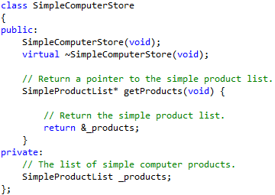
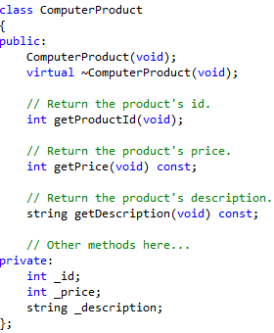
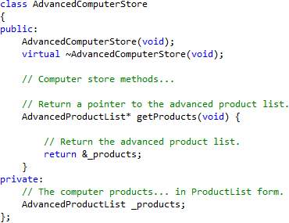
Iterator Design Pattern Example
These could’ve been other collection data structures, arrays, etc.
Consider this case, where code in two different computer store classes use different collection data structures, each with its own unique interface!

Slide 7
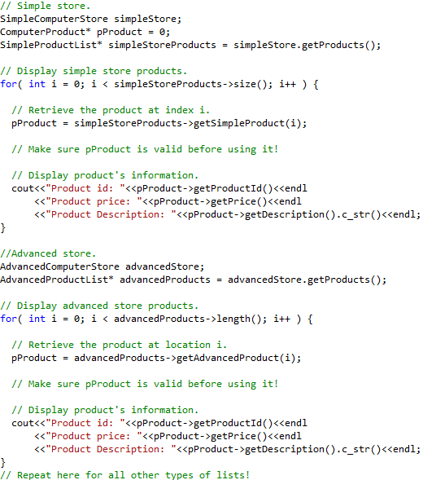
Iterator Design Pattern Example
If a new store is added, we have to modify this code to add code for displaying products of the new store!
Different interfaces require different code!

Slide 8
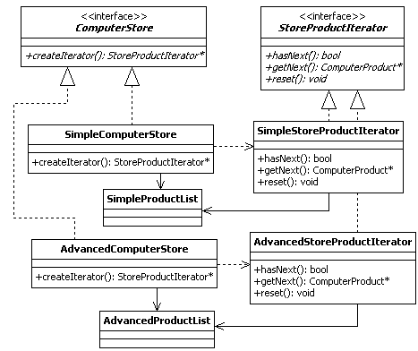
Iterator Design Pattern Example
Notice how in this example we separate the collection data structures from the computer stores!
Notice the pattern! Applying the pattern to the computer store problem entails doing more of the same!
Concrete Iterators must obey the StoreProductIterator interface to provide a uniform way for traversing a collection data structure containing Computer Products
Let’s see how this is implemented…

Slide 9

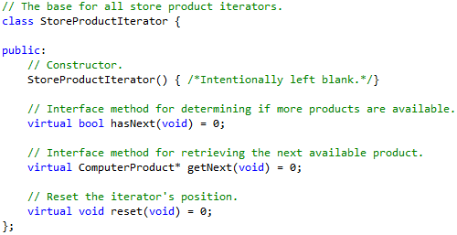
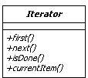
Iterator Design Pattern Example
Common interface for iterating through the products!
Notice that we’re using different interface names than the original pattern!

Slide 10
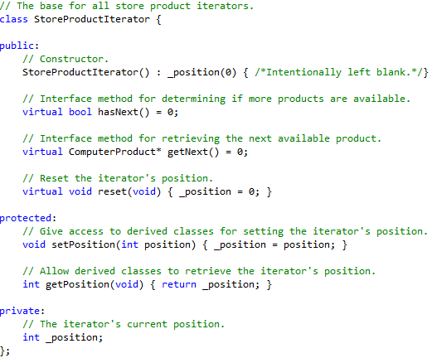
Iterator Design Pattern Example
For this problem, we’ve added some helper methods. It is OK to modify the pattern based on domain knowledge to fit the design to the application!

Slide 11
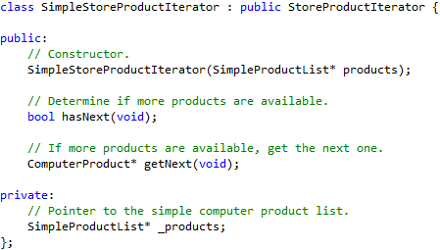
Iterator Design Pattern Example
The Iterator used for the simple store
Requires a simple product data collection!

Slide 12
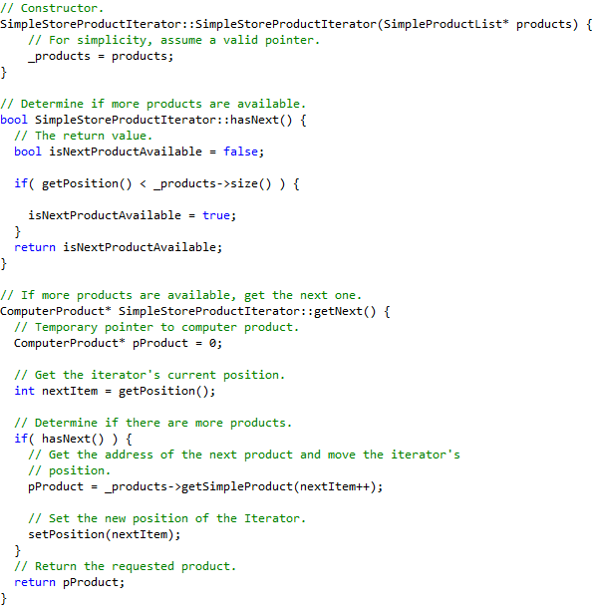
Iterator Design Pattern Example
Common interface allow clients to traverse through the _products objects in this collection, regardless of the difference that may exist in the _products interfaces!
Details / differences are hidden from clients !

Slide 13
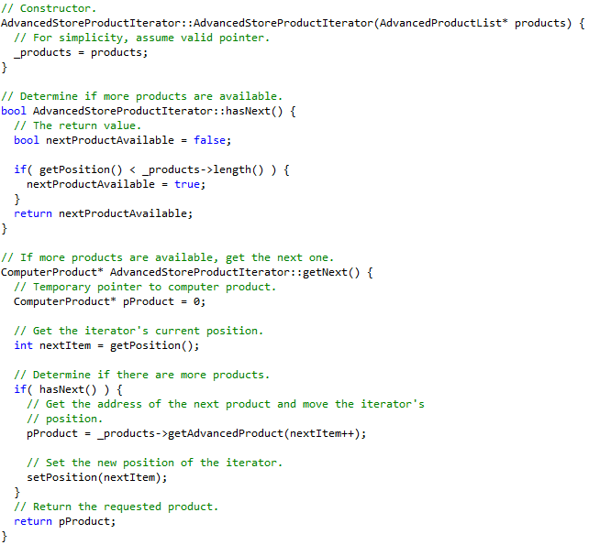
Iterator Design Pattern Example
Common interface allow clients to traverse through the _products objects in this collection, regardless of the difference that may exist in the _products interfaces!
Details / differences are hidden from clients !

Slide 14
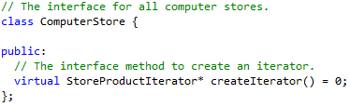
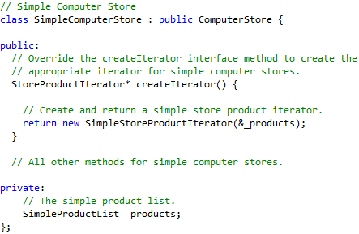
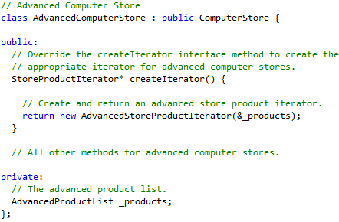
Iterator Design Pattern Example

Slide 15
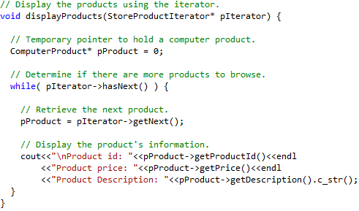
Iterator Design Pattern Example
We can now display product information the same way for any store! With this design, if new stores are added, we can reuse the same displayProduct method to display products!
Iterators are used all over the Java framework, C#, and C++ standard template library!

Slide 16
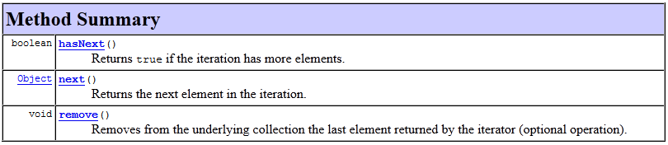
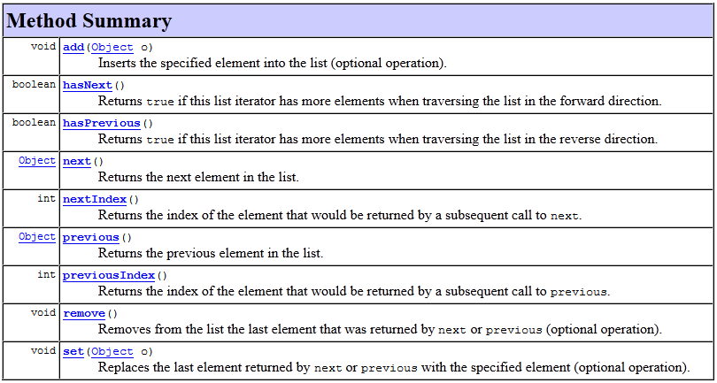
The Java Iterator and ListIterator Interface
Java Iterator
Java ListIterator

Slide 17
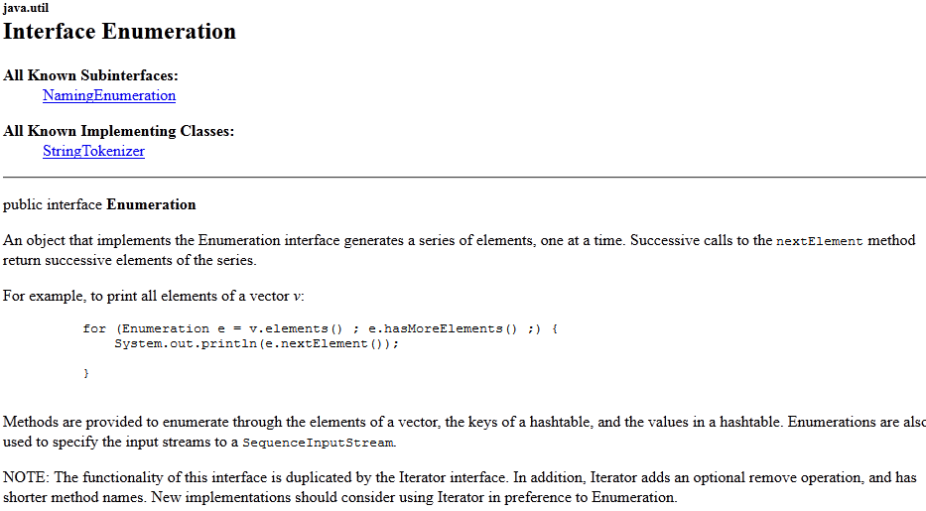
Java Enumeration Interface

Slide 18
Iterator Design Pattern
The step-by-step approach for designing the Iterator design pattern is presented as follows:
  Identify and design the Iterator interface.
  For each class representing a collection data structure in the software system, design a concrete Iterator and associate it with it. Implement the concrete iterator’s methods in terms of the collection data structure.
  Create the Aggregate interface, which includes the interface method to create Iterators.
  For each class representing a collection data structure, implement the Aggregate interface to instantiate and return a concrete Iterator.
Benefits of the Iterator design pattern include:
  The Iterator provides a consistent way for clients to iterate through the objects in a collection.
  It abstracts the internals of the collection objects so that if they change, clients do not have to change.
  Allows client code to be extended easily; numerous iterators can be created to support different traversals from the same or different collection structure.

Slide 19
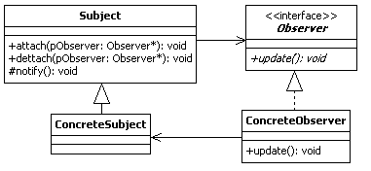
Observer Design Pattern
The Observer design pattern is an object behavioral pattern that standardizes the operations between objects that interoperate using a one-to-many relationship.
According to the GoF, the intent of the Observer is to [1]
  Define a one-to-many dependency between objects so that when one object changes state, all its dependents are notified and updated automatically.

Slide 20
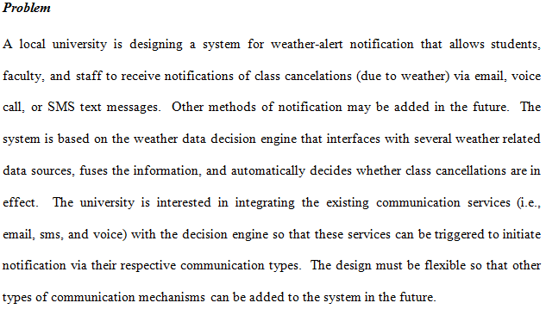
Observer Design Pattern Example

Slide 21
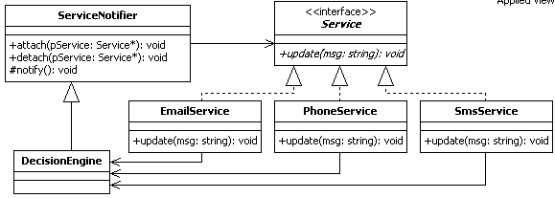
Observer Design Pattern Example

Slide 22
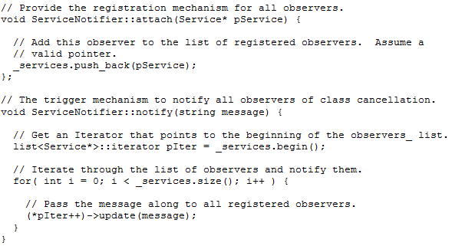
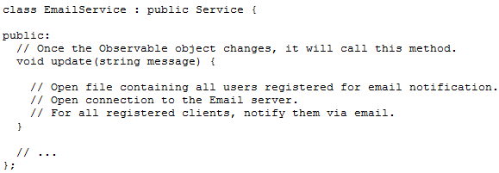
Observer Design Pattern Example

Slide 23
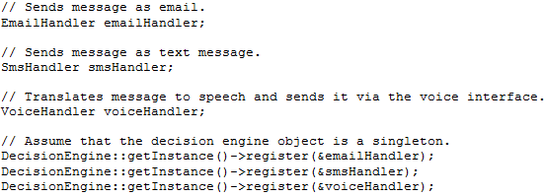
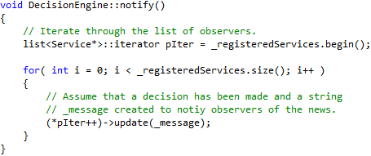
Observer Design Pattern Example
Register observers with the subject, in this case, the DecisionEngine
When a decision is made, the notify method is called to iterate through the list of registered observers to update them with the latest news!

Slide 24
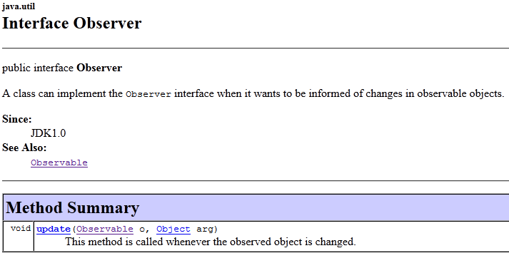
Java Observer Interface

Slide 25
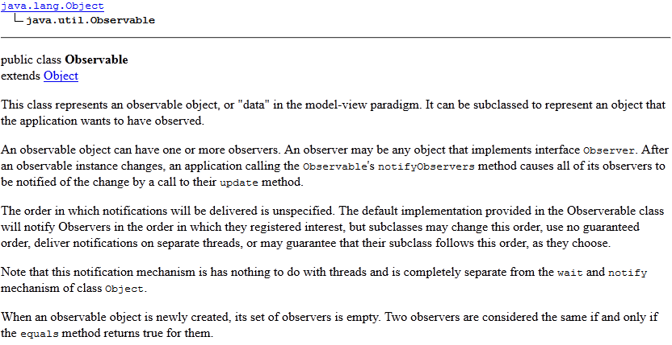
Java Observable
Observers are almost always used within the MVC architecture!

Slide 26
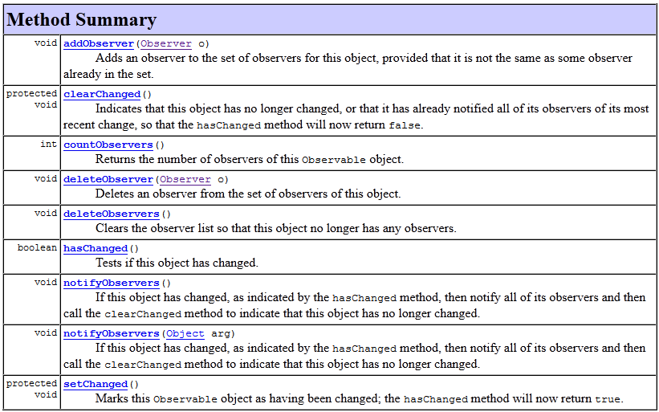
Java Observable Methods

Slide 27
Observer Design Pattern
The steps required to apply the Observer design pattern include:
  Design the Subject interface and implement code for attaching, detaching, and notifying observer objects. The code for keeping track of observers can be done using existing linked-lists data structures.
  For classes that manage information of interests to observers, inherit from the subject class created in step 1.
  Design the Observer interface, which includes the abstract update interface method.
  For all observers in the system, implement the Observer interface, which requires implementing the update method.
  At run-time, create each observer and attach them to the subject. When changes occur, the subject iterates through its list of registered objects, and calls their update method.
Benefits of the Observer design pattern:
  Flexibility for adding new services to the system.
  Since specific services are compartmentalized, maintain and modifying existing system services becomes easier.

Slide 28
What’s Next…
In this session, we presented behavioral design patterns, including:
  Iterator
  Observer
This concludes the presentation of design patterns in detailed design. In the next module, we will present a different form of design which occurs (mostly) at the function-level. We refer to this form of design as construction design.

Slide 29
References
[1] Gamma, Erich, Richard Helm, Ralph Johnson, and John Vlissides. Design Patterns: Elements of Reusable Object-Oriented Software. Boston: Addison-Wesley, 1995.

